Slide 1
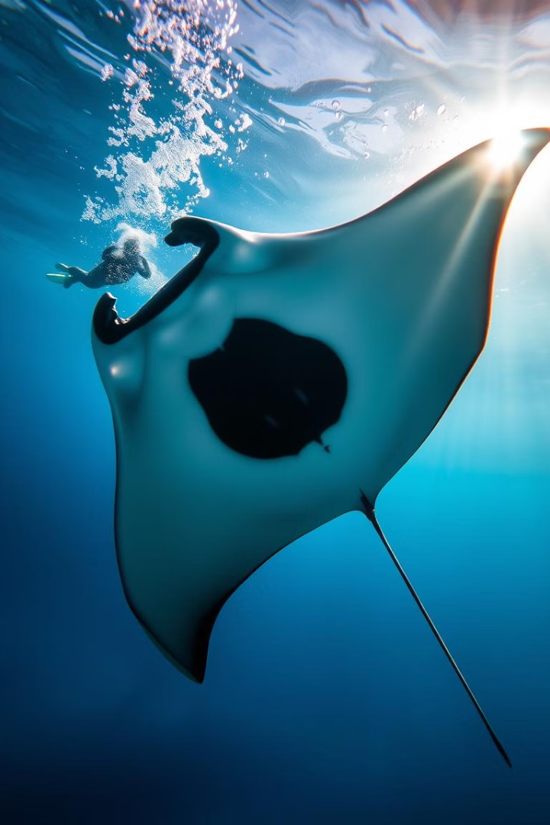
Underwater Photography and Videography: Mastering the Depths
Explore the captivating world beneath the waves through the lens of underwater photography and videography. Dive into the challenges and uncover the solutions to capturing stunning visuals in this unique environment.
Presented By :
S. Akash (546)
G. Sandhya (515)
Aqsa Maha (LE: 502)

Slide 2
Light Absorption and Scattering in Water
Light Absorption
Light Scattering
Color Distortion
Water absorbs specific wavelengths of light, leading to a shift in color and reduced visibility, especially in deeper depths.
Suspended particles in the water scatter light, creating a hazy, veiled appearance and diminishing image clarity.
The selective absorption of light wavelengths results in a shift in the perceived colors of underwater subjects.

Slide 3
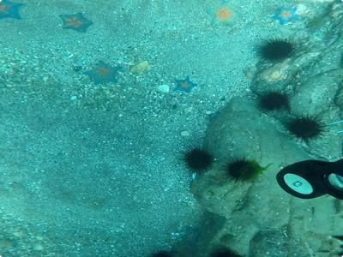

Reduced Visibility and Loss of Color Fidelity
1
Haze and Backscatter
2
Color Loss
The absorption of light wavelengths leads to a loss of color fidelity, with subjects appearing muted and less vibrant.
Suspended particles in the water scatter light, creating a hazy effect that reduces visibility and clarity.
3
Depth Dependence
These challenges become more pronounced at greater depths, where the water column is denser and light penetration is reduced.

Slide 4
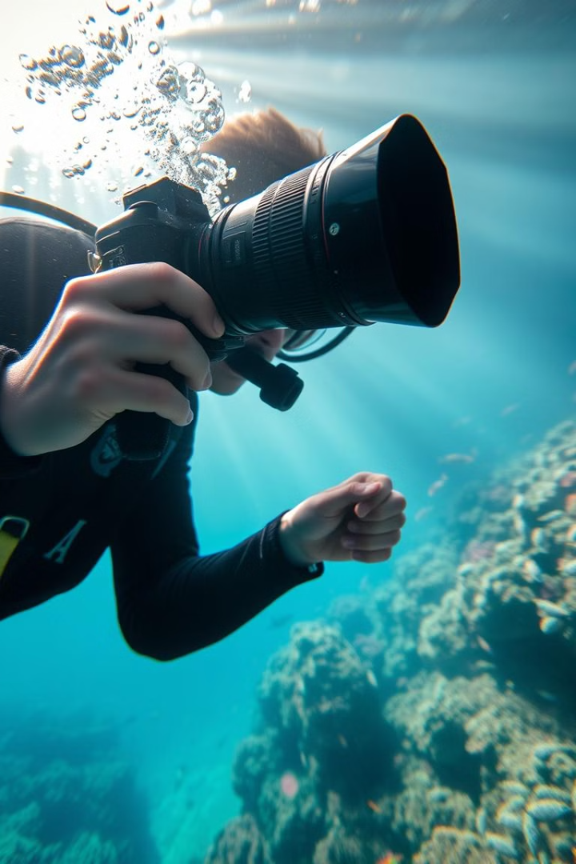
Limitations of Traditional Underwater Imaging Techniques
Camera Limitations
Post-Processing Challenges
Standard camera equipment struggles to compensate for the unique optical properties of the underwater environment.
Traditional image editing techniques often fail to effectively restore the lost color and clarity of underwater imagery.
Operational Constraints
The physical limitations of diving and underwater photography can further impact image quality and consistency.

Slide 5
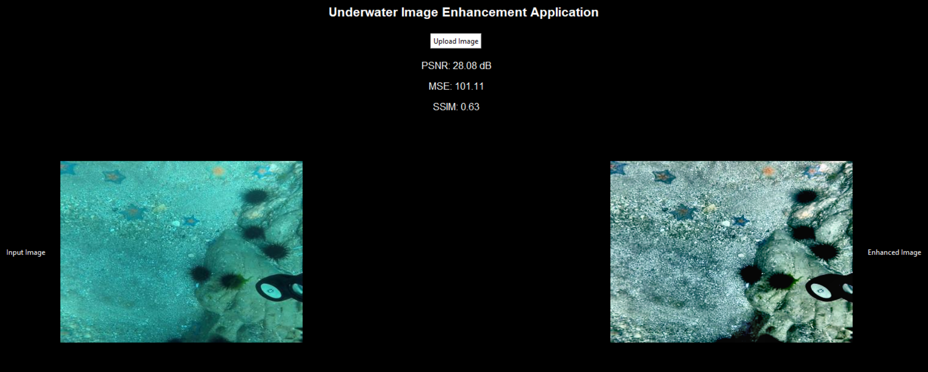



Advances in Underwater Image Processing and Enhancement
Computational Photography
Leveraging computational techniques to capture and process images with improved color, contrast, and clarity.
Image Restoration
Applying advanced algorithms to remove haze, correct color distortion, and enhance underwater visual quality.
Analytical Modeling
Developing analytical models to understand and compensate for the unique optical properties of the underwater environment.

Slide 6
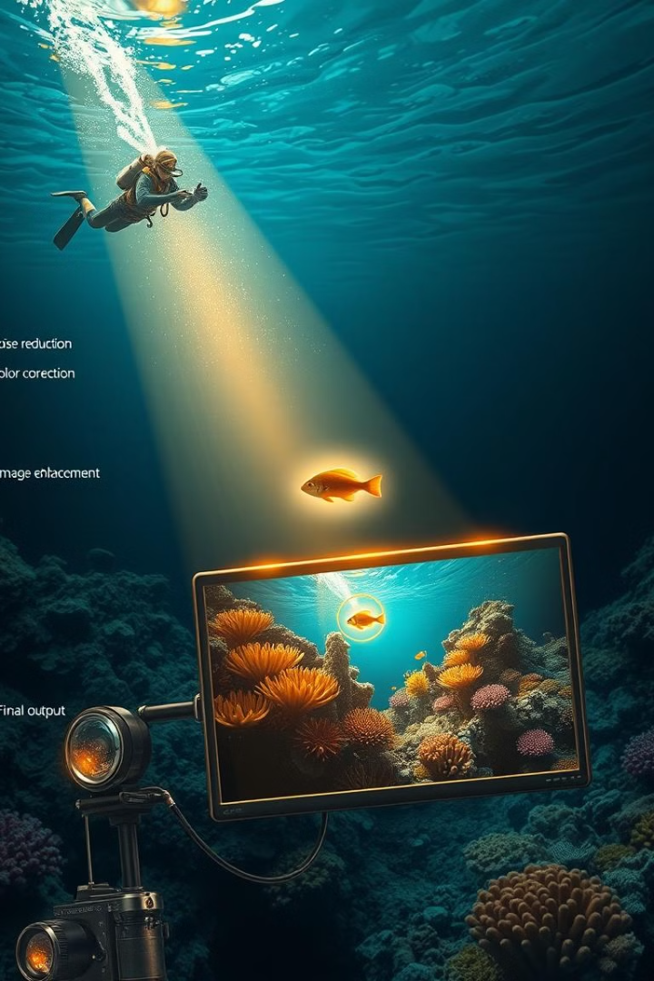
Computational Methods for Improved Underwater Imaging
1
Image Dehazing
Removing the effects of backscatter and haze to improve visibility and clarity.
2
Color Correction
Restoring the true colors of underwater subjects by compensating for wavelength-dependent light absorption.
3
Super-Resolution
Enhancing image resolution and detail through advanced upscaling techniques.

Slide 7
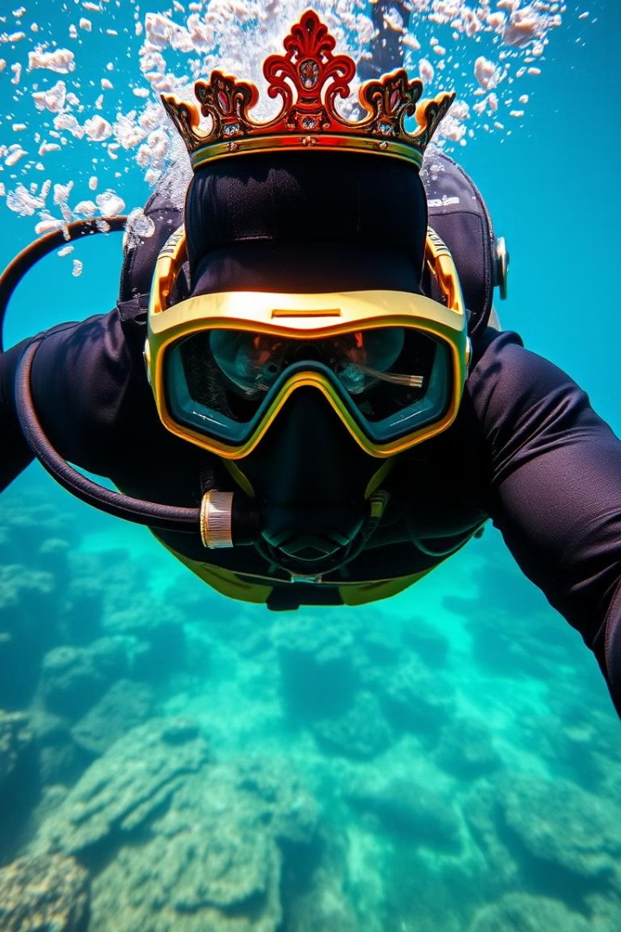



Emerging Techniques for Underwater Visual Clarity
Structured Illumination
Utilizing specialized lighting patterns to reduce backscatter and improve image contrast.
Polarization Imaging
Leveraging the polarization properties of light to mitigate the effects of scattering and haze.
Multi-Spectral Sensing
Capturing images across a broader range of the electromagnetic spectrum to enhance underwater visibility.

Slide 8
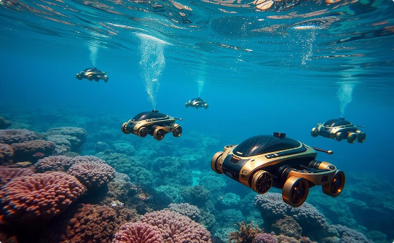
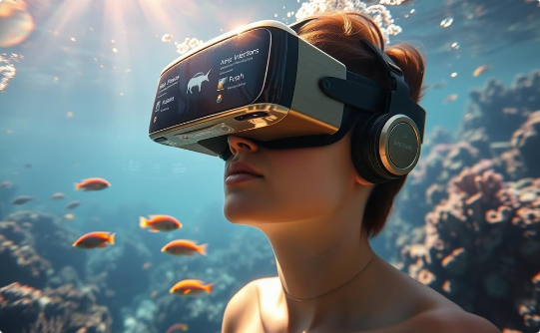
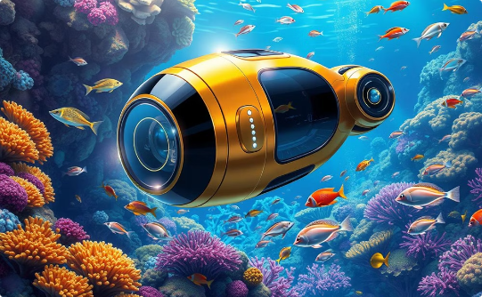
Future Directions and Applications of Underwater Imaging
Robotics and Autonomy
Virtual and Augmented Reality
Environmental Monitoring
Integrating advanced underwater imaging systems into robotic platforms for marine exploration and surveying.
Utilizing enhanced underwater imaging for monitoring, assessment, and conservation of marine ecosystems.
Leveraging high-quality underwater imagery to create immersive virtual and augmented reality experiences.

